Slide 1
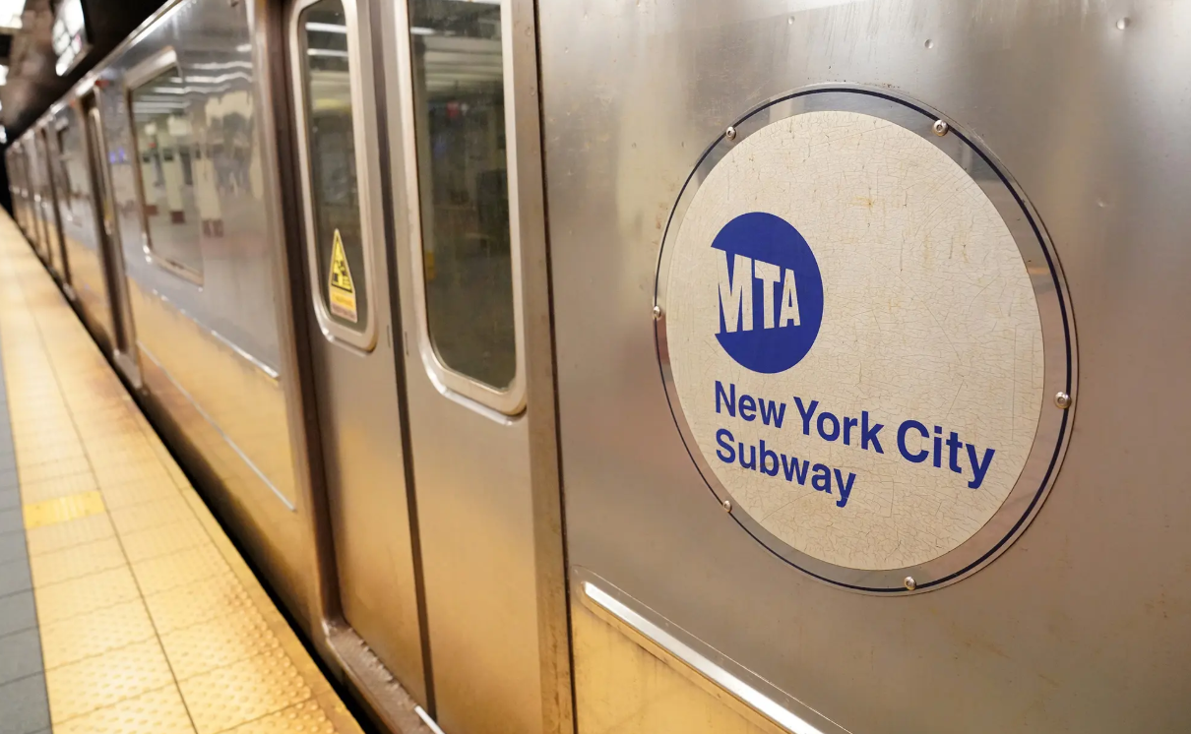
MTA Ridership Project
Presented by:
Omar Saeed Bassel Mohamed Shahd Ahmed

Slide 2
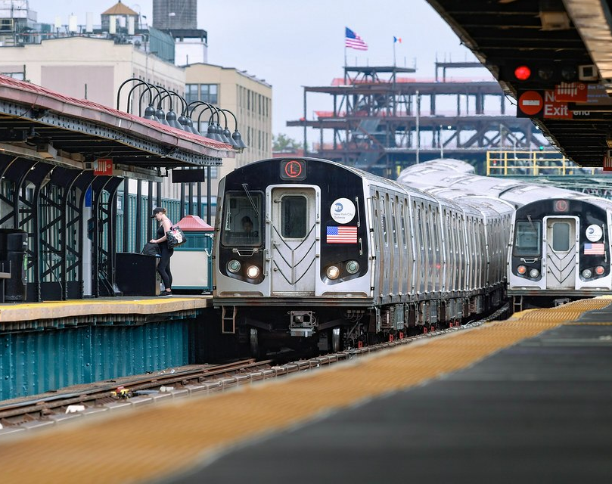
Project Description
This project analyzes ridership data for seven transportation services in New York City, capturing the total number of riders for each mode of transportation per day. The dataset includes pre-pandemic ridership percentage columns, allowing for a clear comparison across different time periods. Using Excel, Power Query, and Power BI, the project aimed to uncover patterns in rider behavior before, during, and after the COVID-19 pandemic.

Slide 3
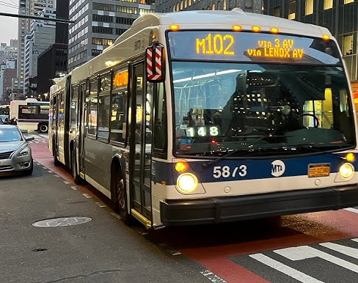
Project Objective
To compare ridership trends across years for each transportation type, focusing on changes before (2019), during (2020–2021), and after (2022–2024) the COVID-19 pandemic. The goal was to understand how rider volumes fluctuated and which services saw faster recovery.

Slide 4
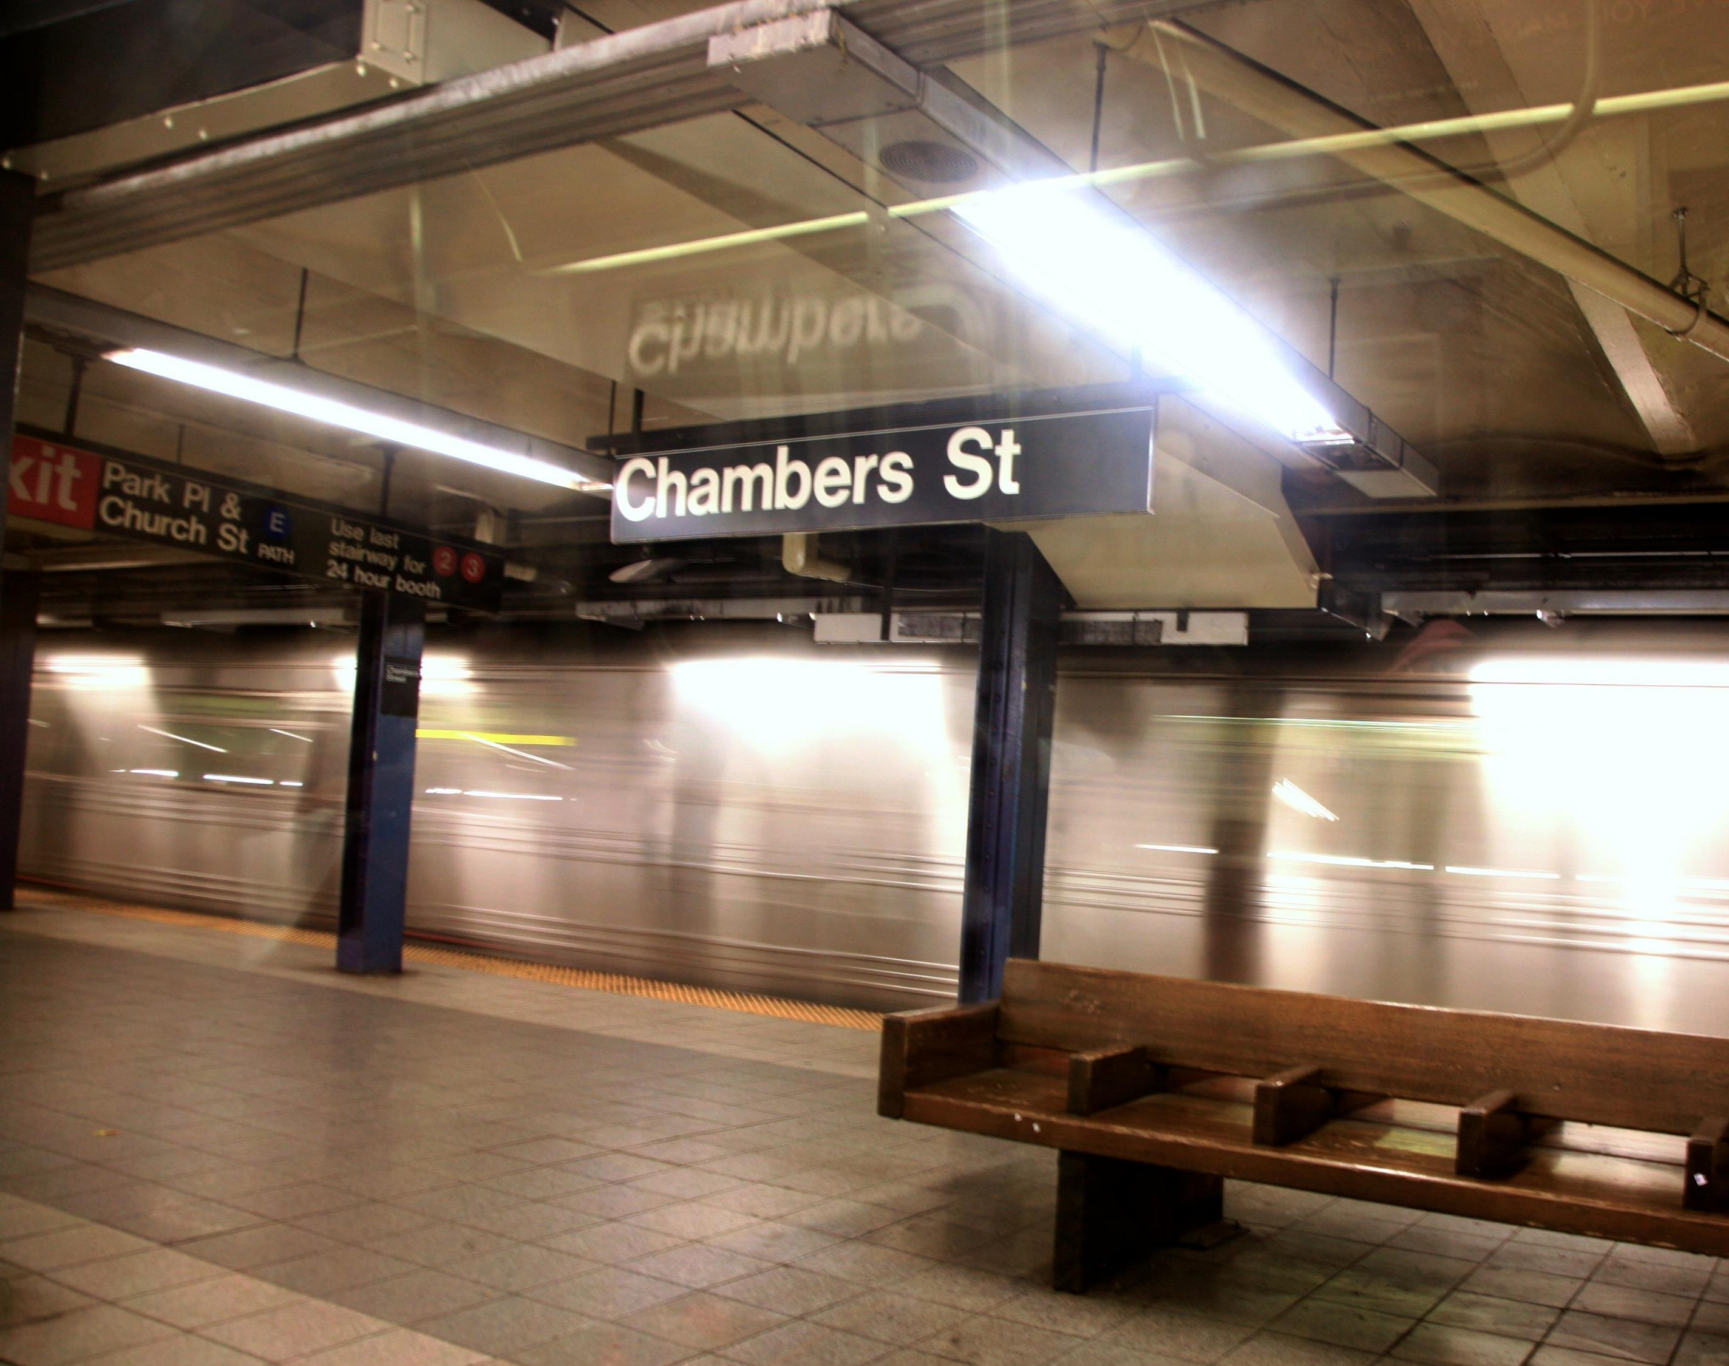
Data Source
CSV file containing MTA ridership data, including daily rider counts and pre-pandemic comparison percentages.

Slide 5
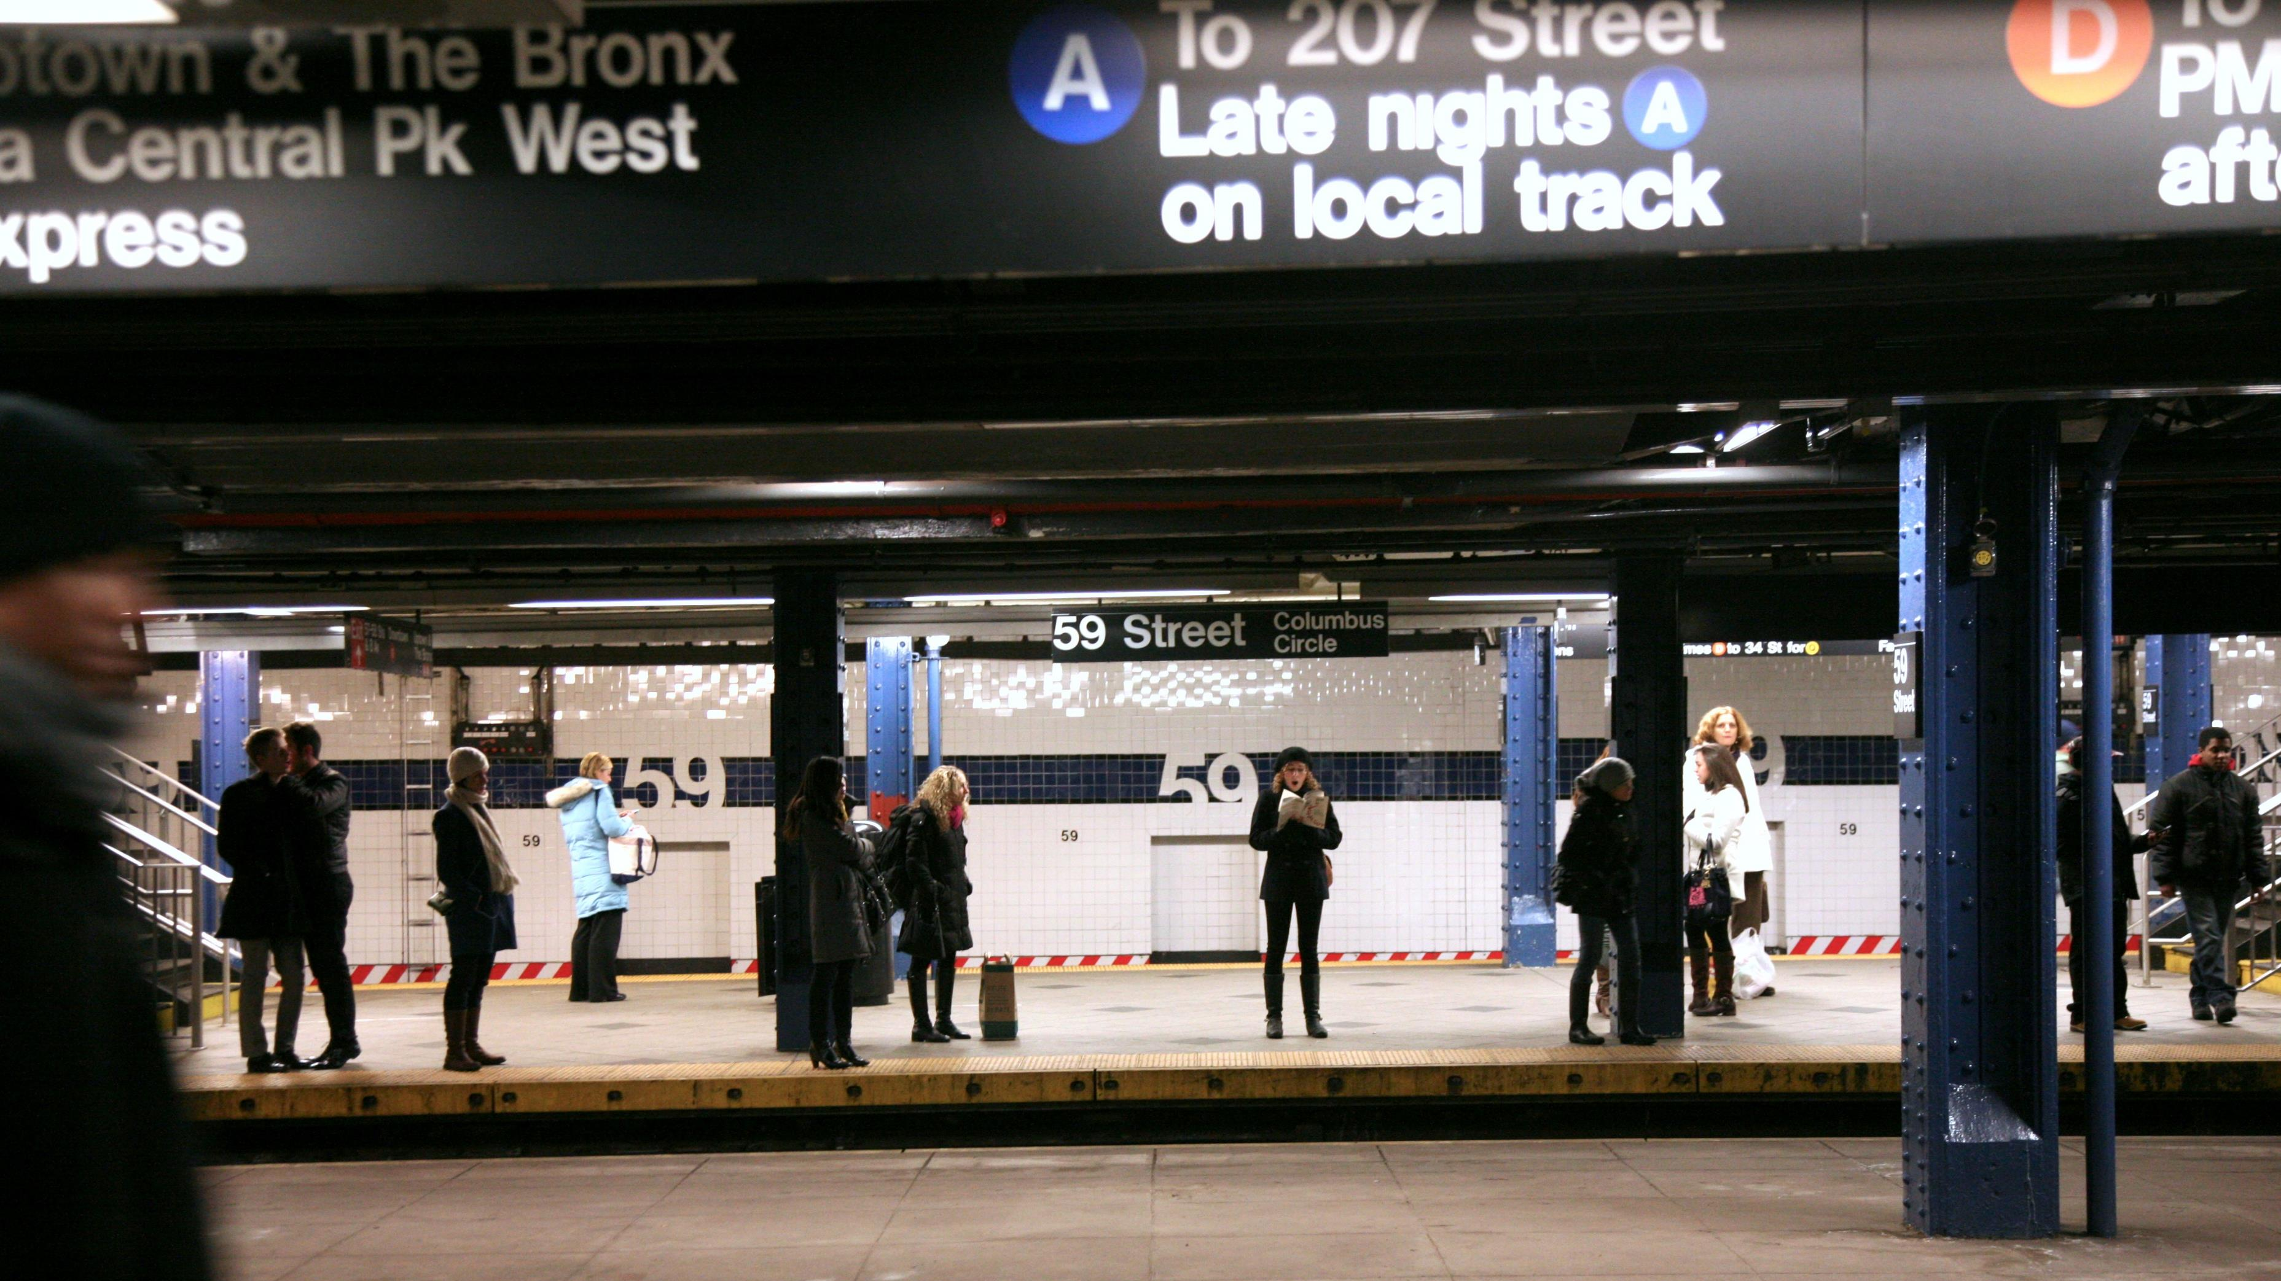



Our Tools

Slide 6
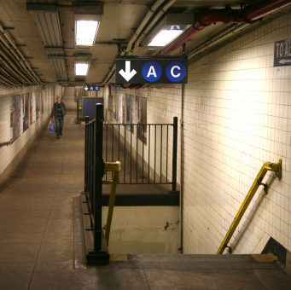
First Phase: Cleaning
Headers Standardization
Conversion of 2019 Passenger Data
Separation of 2019 Data
Data Sorting
Validation & Quality Checks

Slide 7
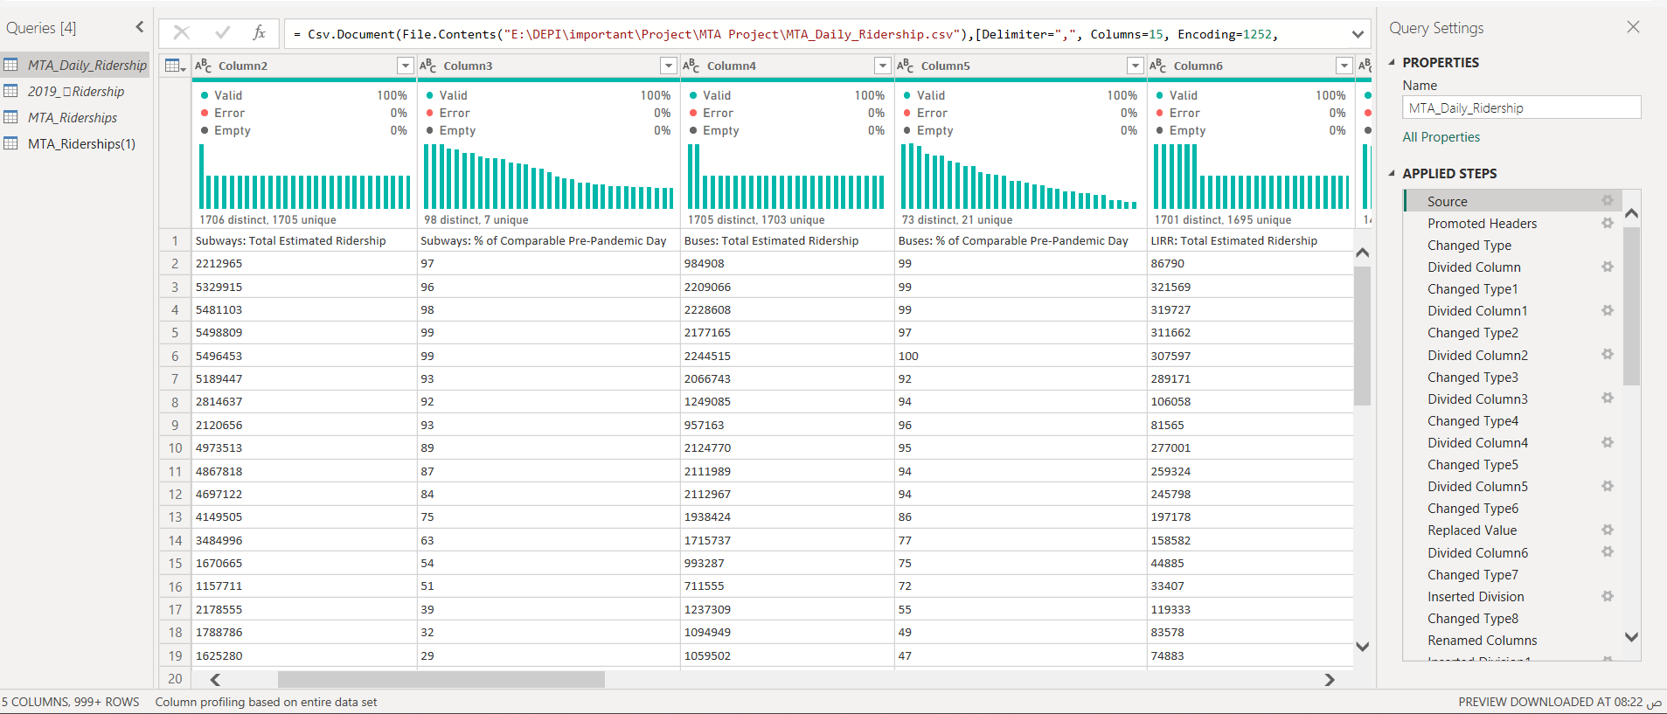
Before

Slide 8
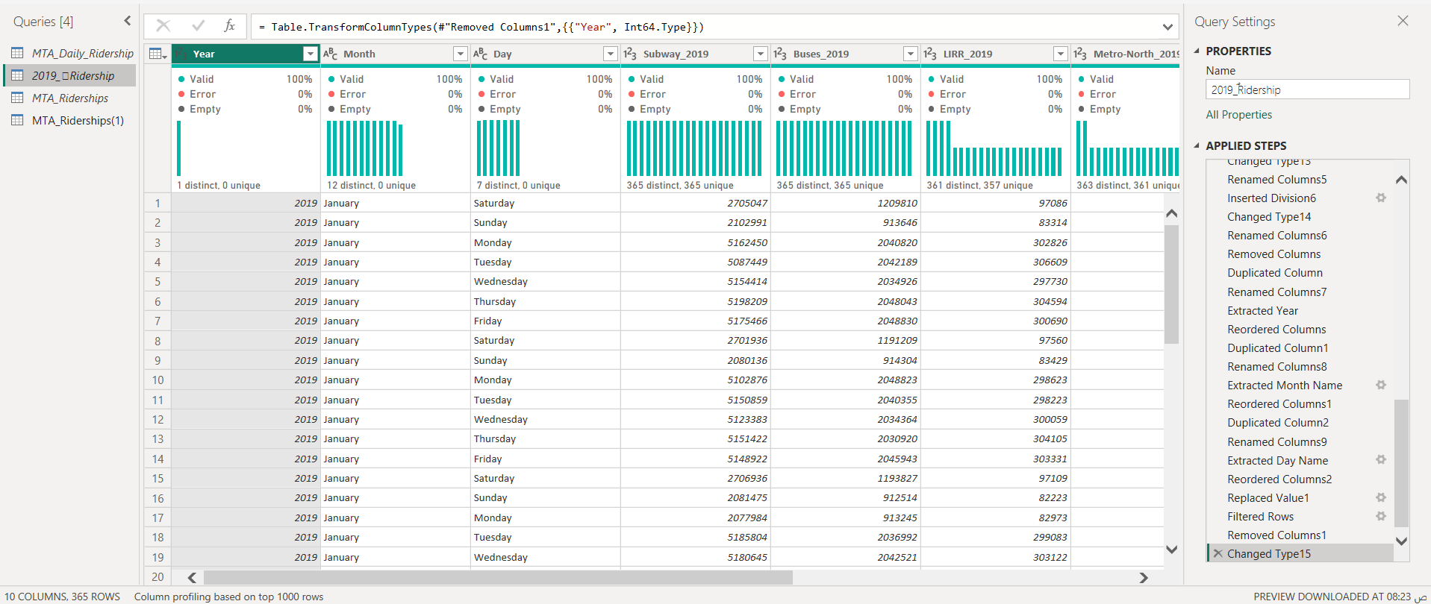
After

Slide 9
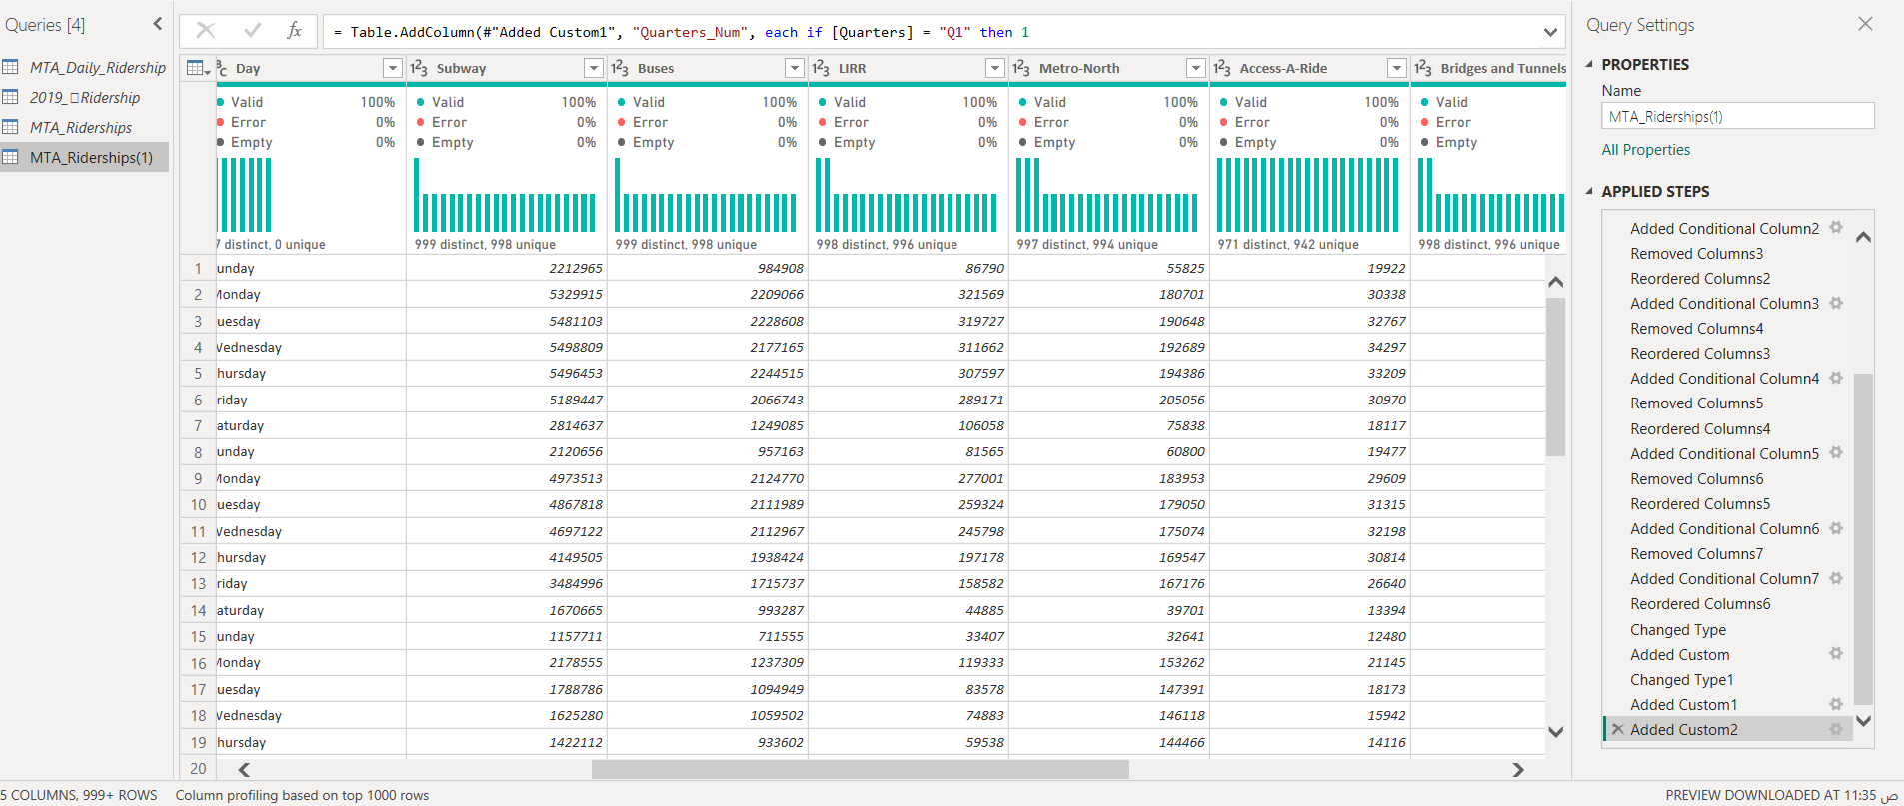

Slide 10
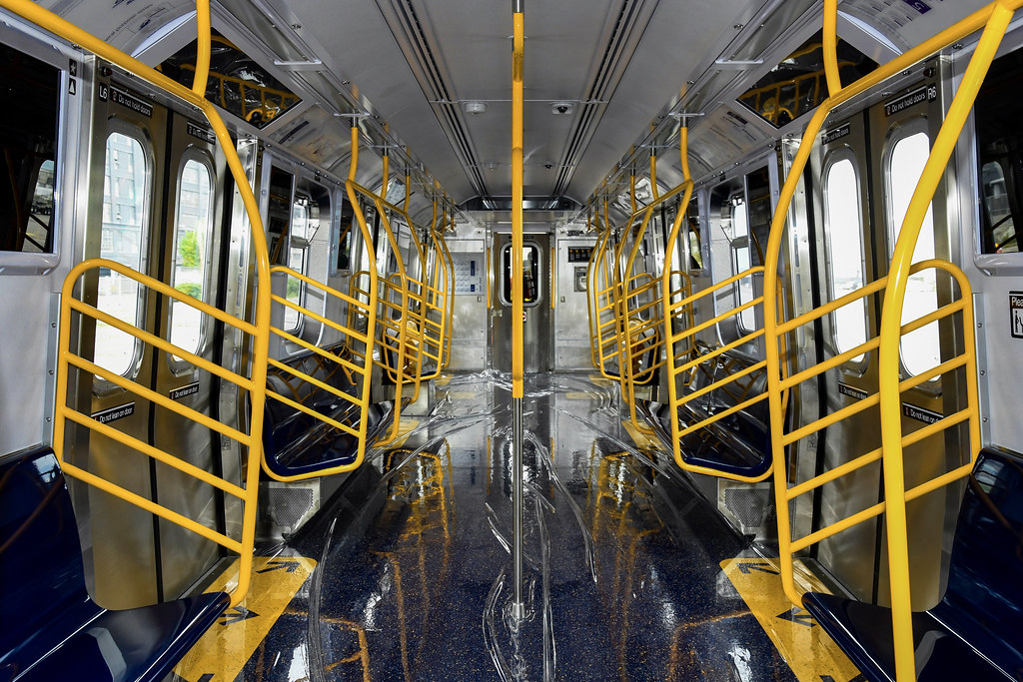
Second Phase: Analyzing & Insights
Pre-pandemic ridership was significantly higher than during and after the pandemic.
2020 recorded the sharpest decline in total ridership with a 69% change compared to 2019 due to COVID-19 restrictions.
Subway was the most utilized transportation mode, followed by bridges and tunnels (traffic data).
Weekends and holidays had lower ridership compared to weekdays.
Ridership recovery increased steadily each year, indicating progressive normalization in public transport usage post-pandemic.
This Photo by Unknown Author is licensed under CC BY

Slide 11
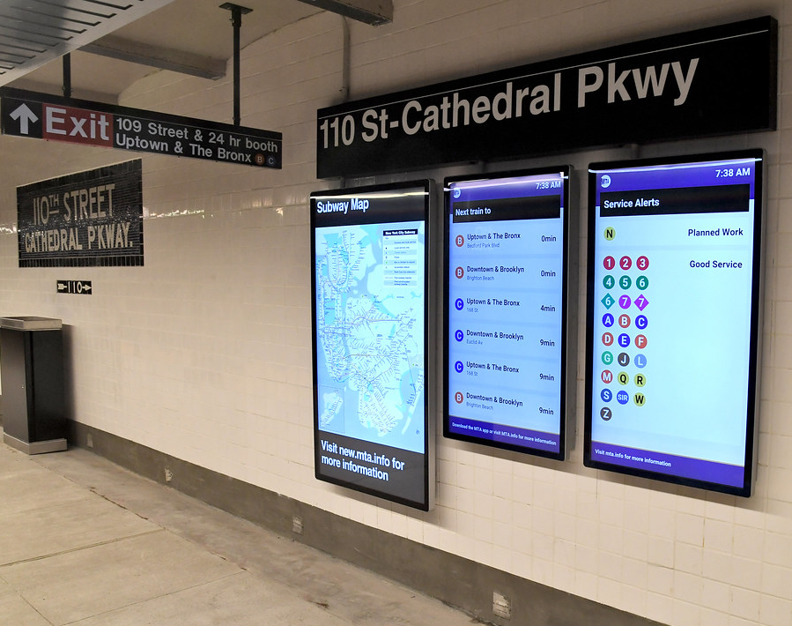
Third Phase: visualization
Line Charts used to show year-over-year trends in ridership for each transportation mode.
Cards used to highlight key metrics such as total ridership, average volume, and peak values.
Donut charts break down total ridership by pandemic phases, helping us visualize the share of each period.
This Photo by Unknown Author is licensed under CC BY

Slide 12
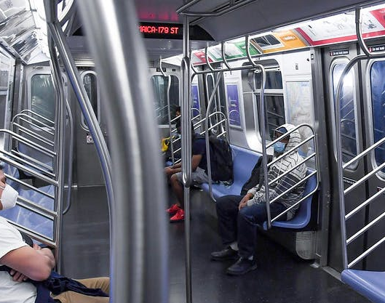
Recommendations:
Targeted service optimization during weekdays where rider volume is high, and cost-saving reductions on weekends and holidays.
Invest more in subway infrastructure and service quality, as it remains the most used mode.
Use traffic data (bridges & tunnels) as a proxy for shifts to personal car usage during crises, and explore integrating this insight into emergency transportation planning.
Promote safety and public trust in transportation services to accelerate post-pandemic recovery, especially for modes with slower rebound rates.

Slide 13


